Slide 1
Open Lab 5: Advanced ML – Ensemble Learning and Optimization

Slide 2
Machine Learning and Deep Learning Series
Open Lab 1: Introduction to Machine Learning and Deep Learning
Open Lab 2: Supervised Learning – Classification
Open Lab 3: Supervised Learning – Regression
Open Lab 4: Unsupervised Learning
Open Lab 5: Advanced ML – Ensemble Learning and Optimization
Open Lab 6: Deep Learning and Neural Networks
Open Lab 7: Transformer-based Models

Slide 3
Couple of Points
Last classic ML open lab
Simplified explanations
Little math but focused on followable steps
Recommend to check prior ML labs on regression and classification

Slide 4
Ensemble Learning
Key Idea: Many (weak) models(learnings) together create a strong model/results.
Why Important?
Improves performance
Reduce overfitting
Handles Bias-Variance trade-off
More Robust Predictions
Primarily used in industry
Key Types
Bagging:
Boosting:
Stacking

Slide 5
Patient | Fever | Cough | Body Ache | Doctor 1 | Doctor 2 – little | Doctor 3- expert
Patient 1 | Fever | No Cough | Body Ache | Flu | Flu | COVID-19
Patient 2 | No Fever | Cough | Body Ache | COVID-19 | COVID-19 | Flu
Patient 3 | Fever | Cough | No Body Ache | Flu | Flu | Flu
Patient 4 | No Fever | No Cough | Body Ache | COVID-19 | Flu | COVID-19
Patient 5 | Fever | No Cough | No Body Ache | Flu | Flu | Flu
Key Types
Bagging: Majority Voting
Boosting: One doctor learns from mistakes of previous doctor
Stacking: Fourth doctor explores results from the previous three doctors

Slide 6
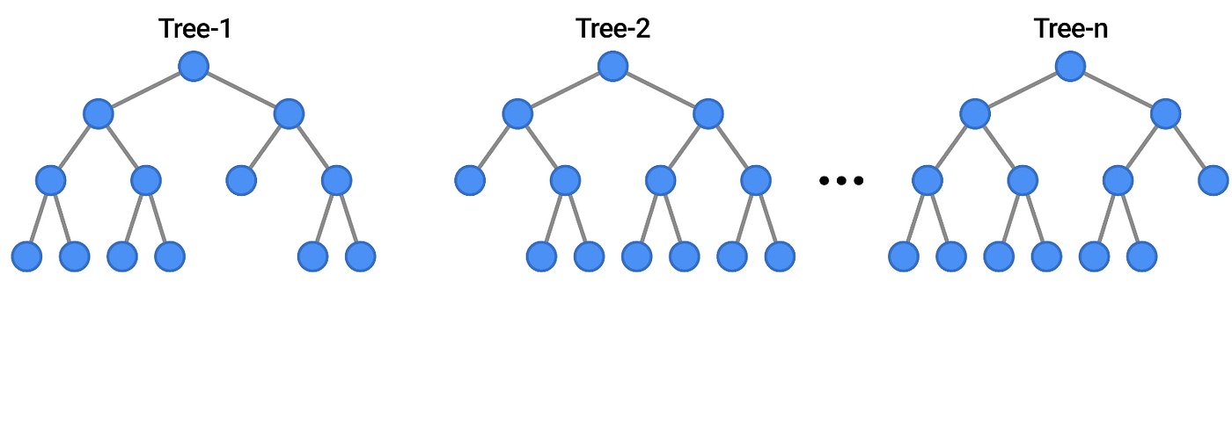
Bagging is Collection of Decision Trees

Slide 7
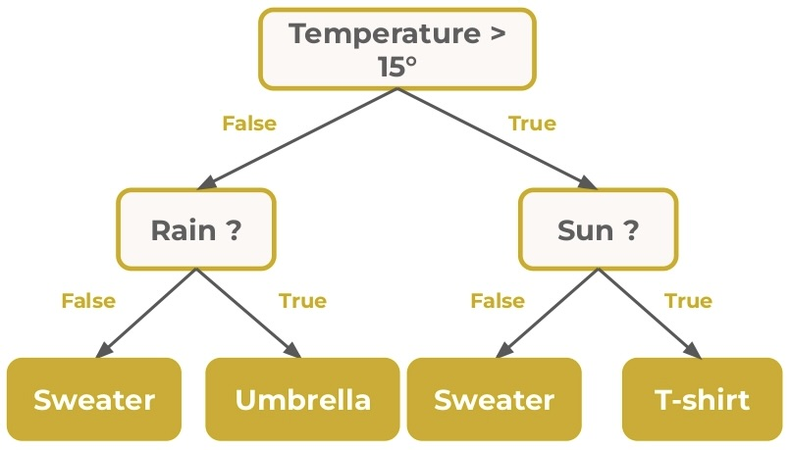
Why Bagging? Decision Tree Reminder

Slide 8
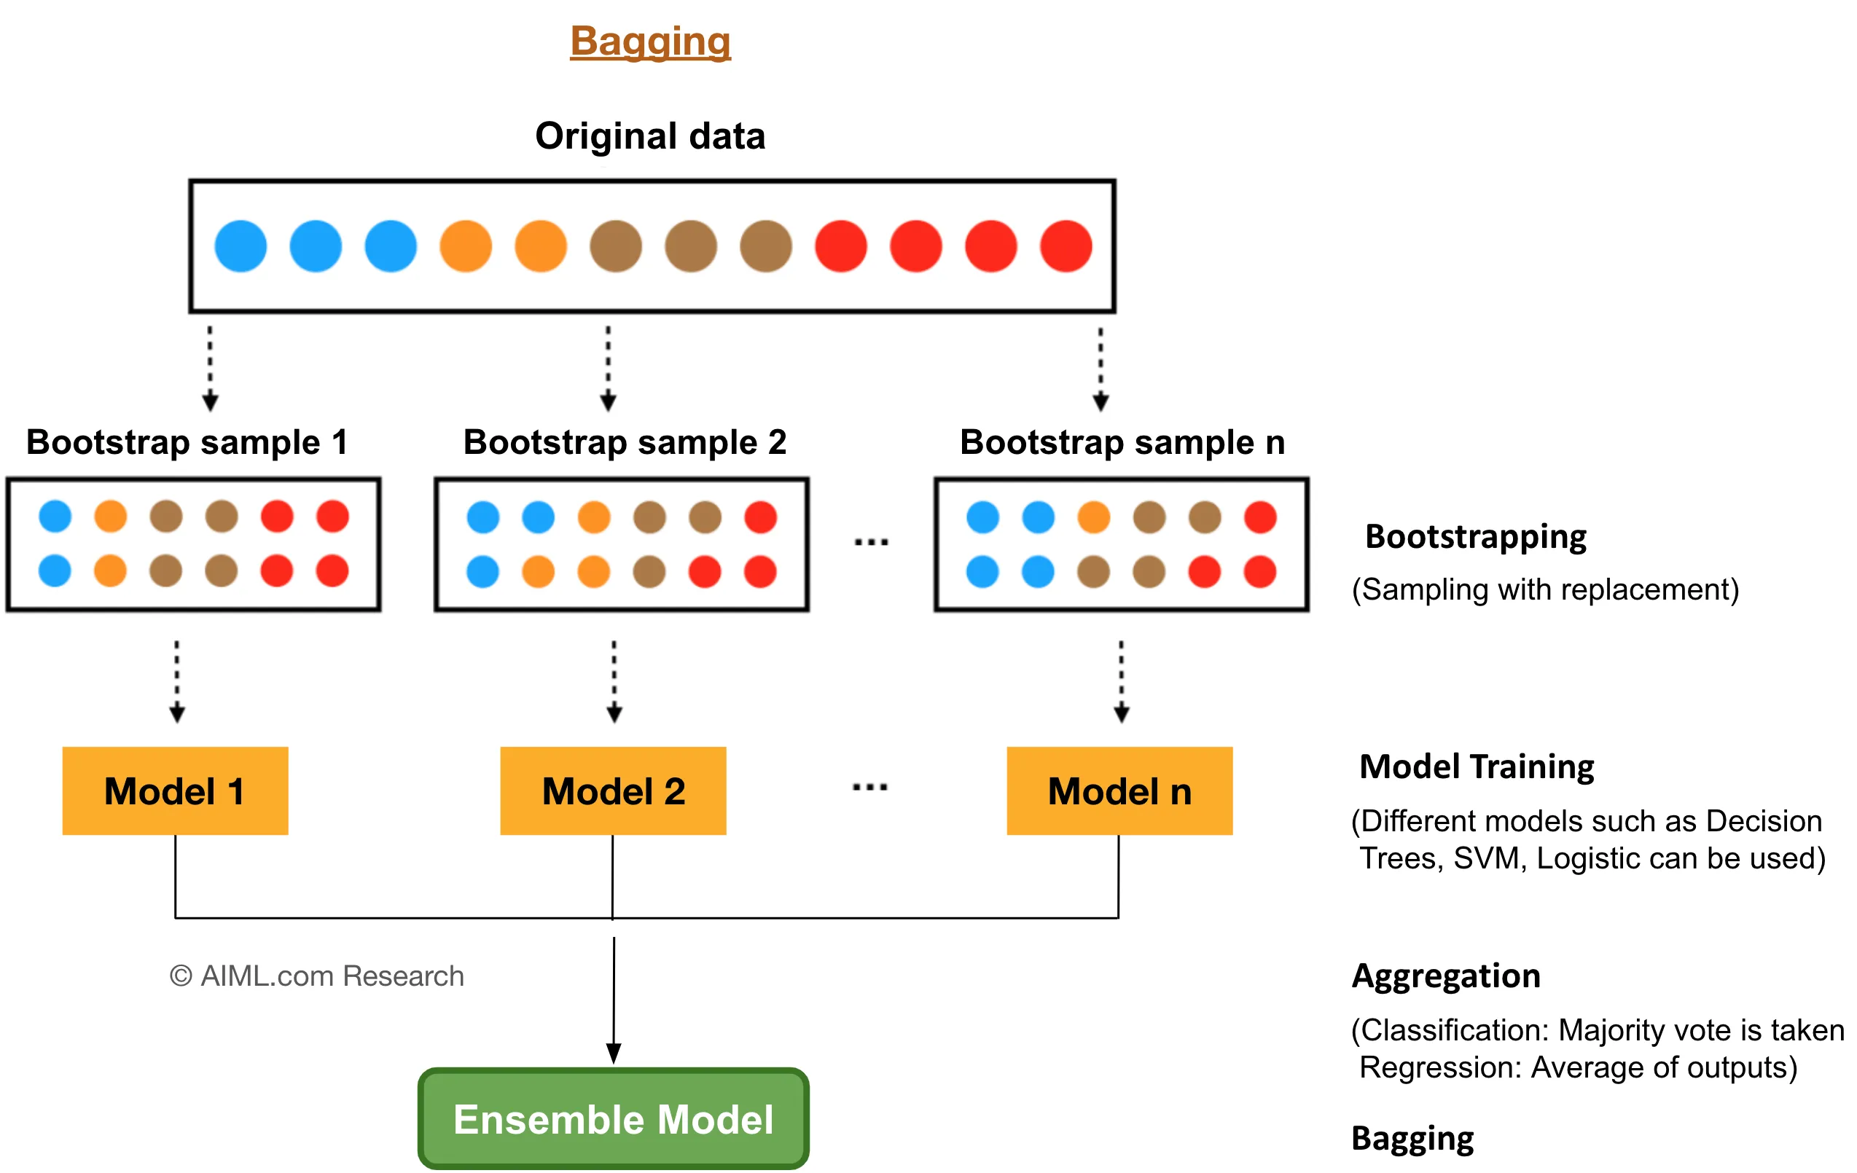
Bagging = Bootstrap + Aggregating

Slide 9
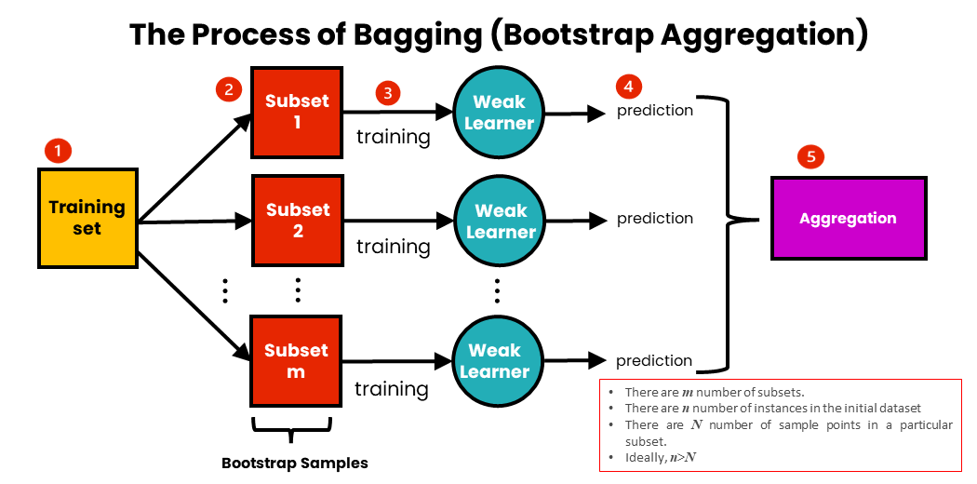

Slide 10
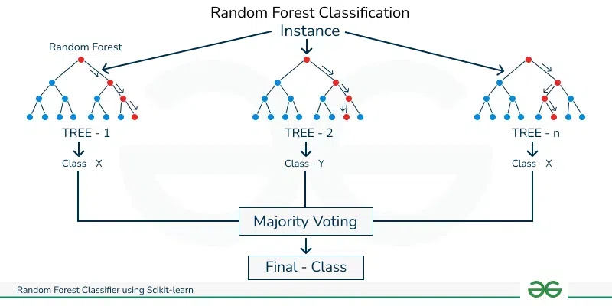
Random Forest is Key Bagging Algorithm: Classification

Slide 11
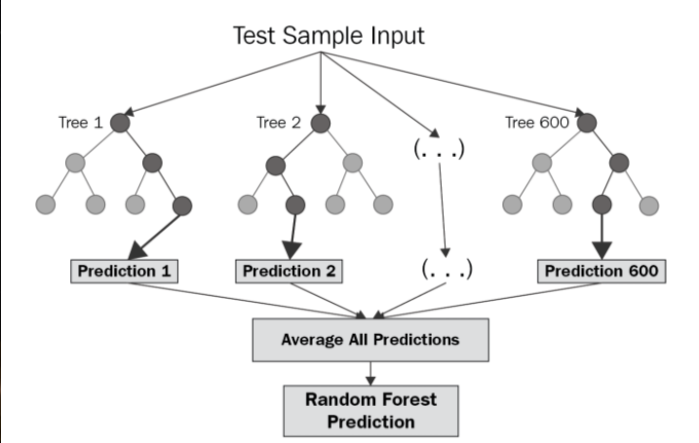
Random Forest: Regression

Slide 12
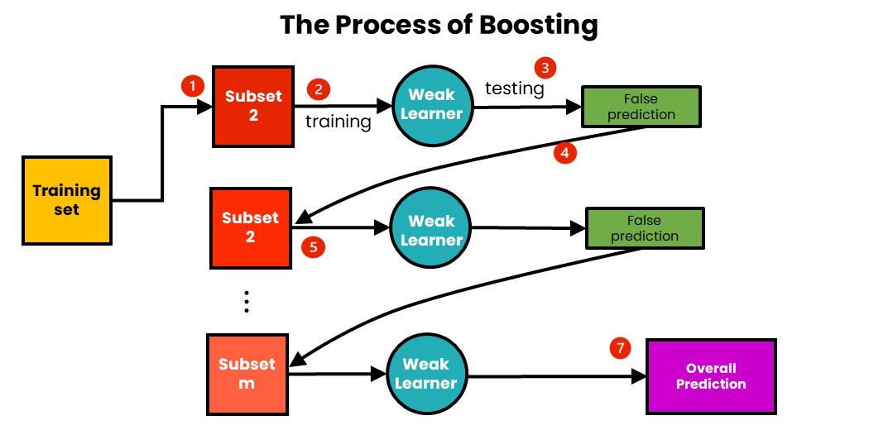
Boosting

Slide 13
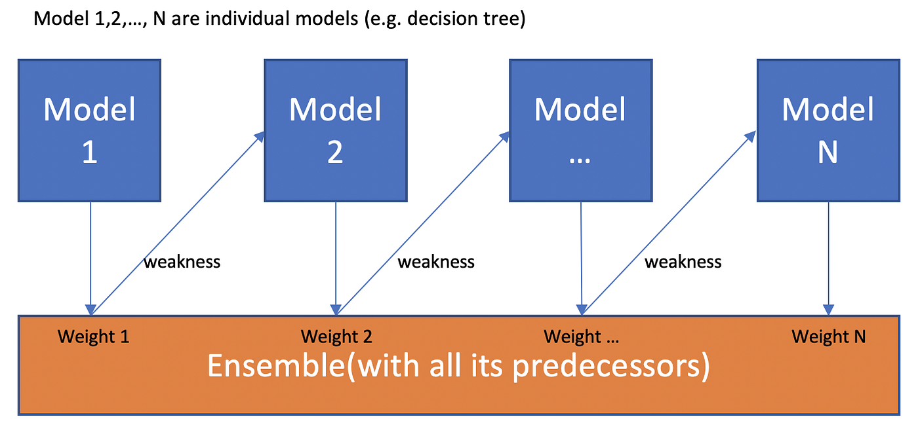
Boosting

Slide 14
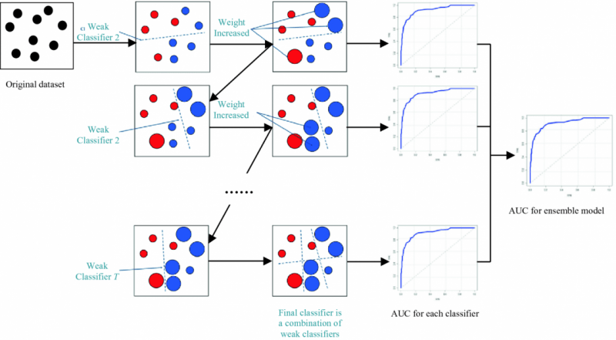

Slide 15
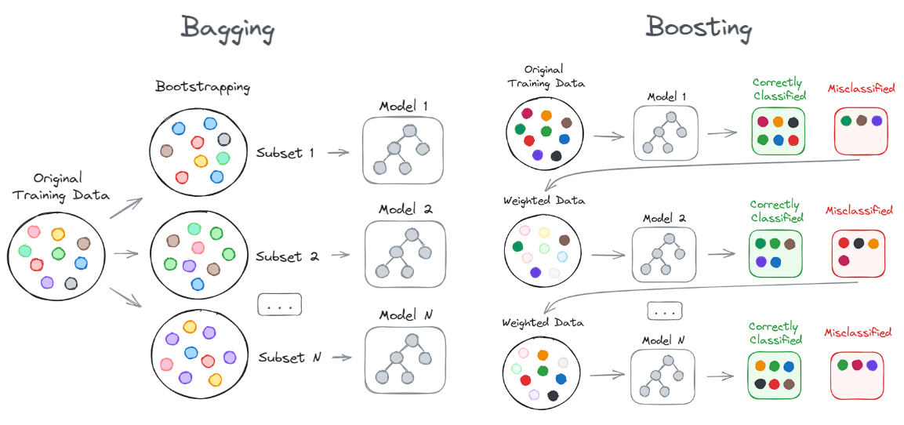

Slide 16
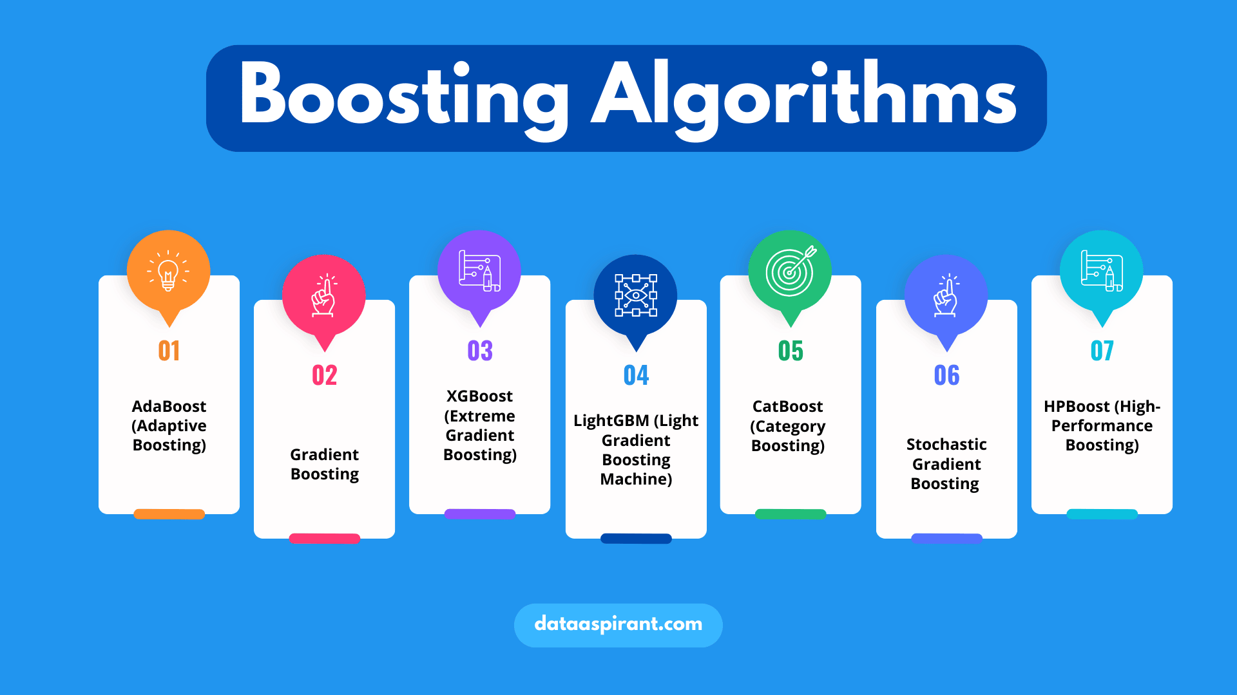
Types of Boosting Algorithms

Slide 17
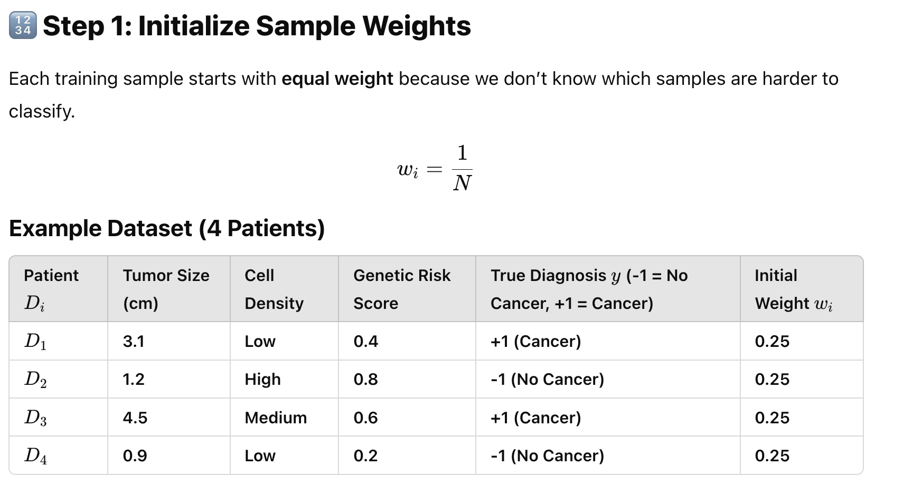

Slide 18
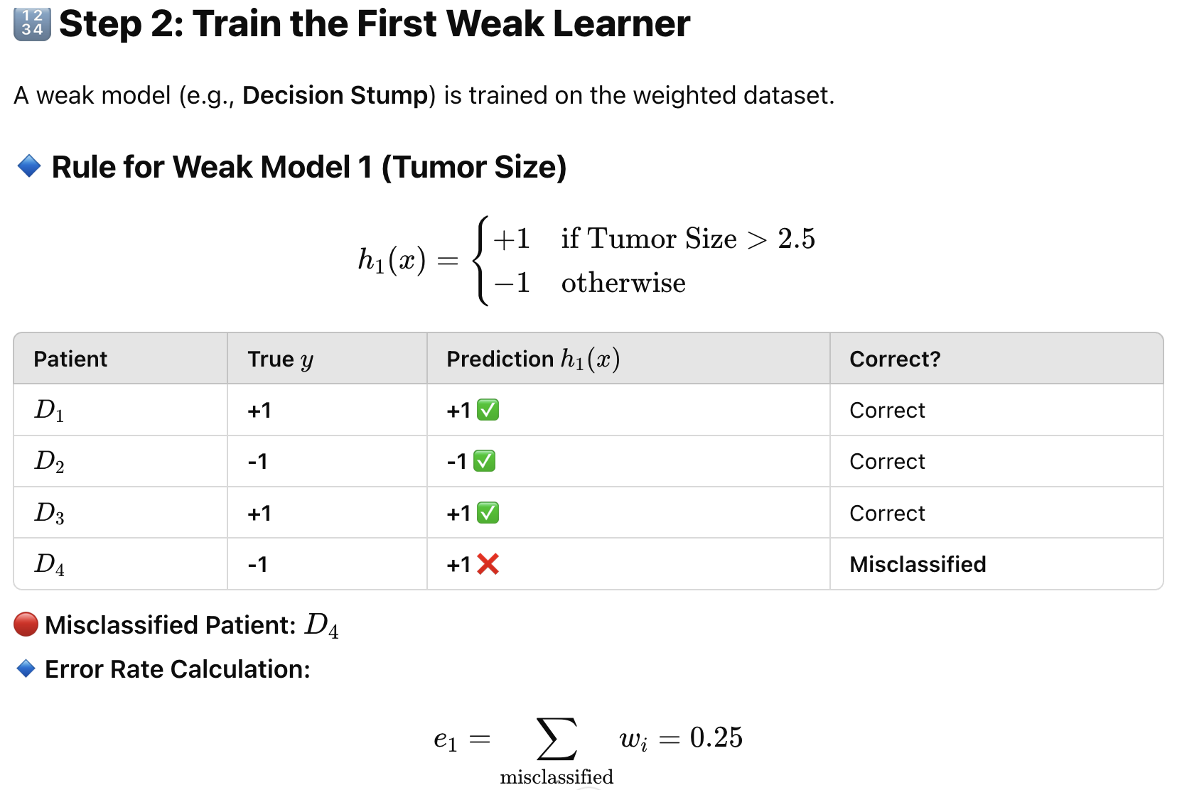

Slide 19
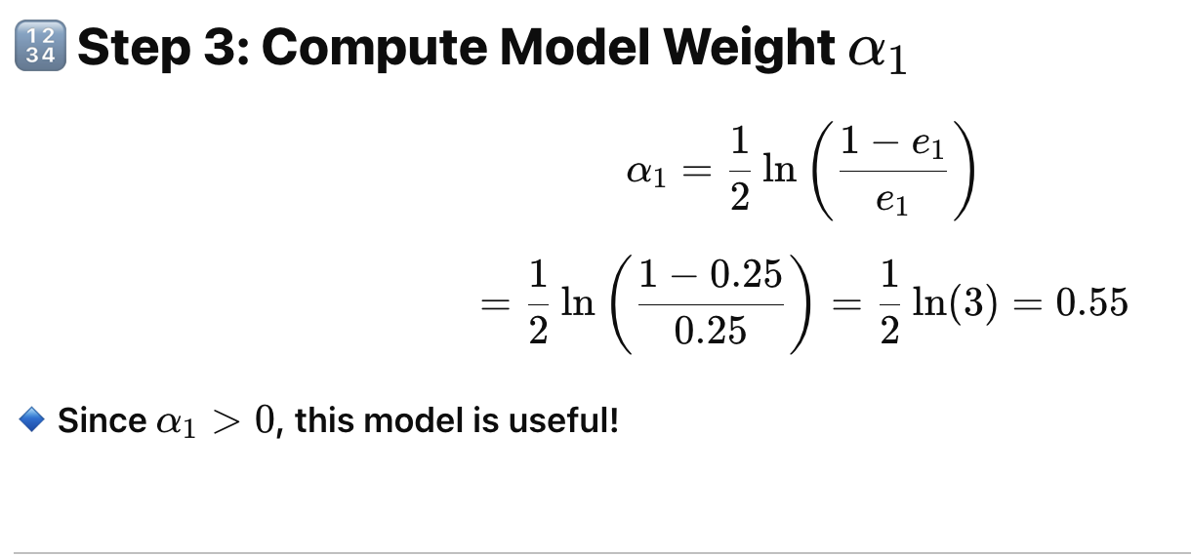

Slide 20
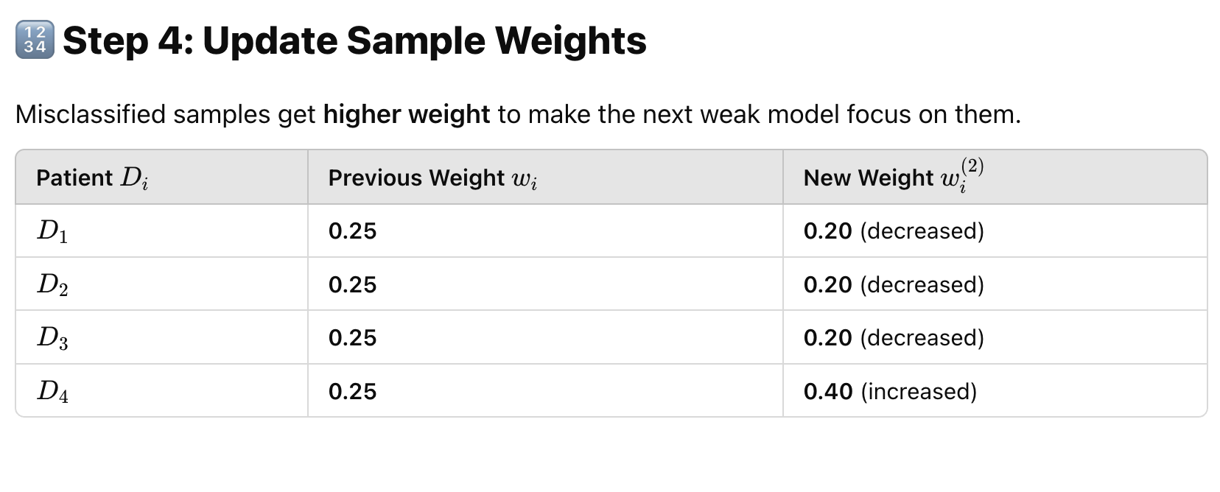

Slide 21
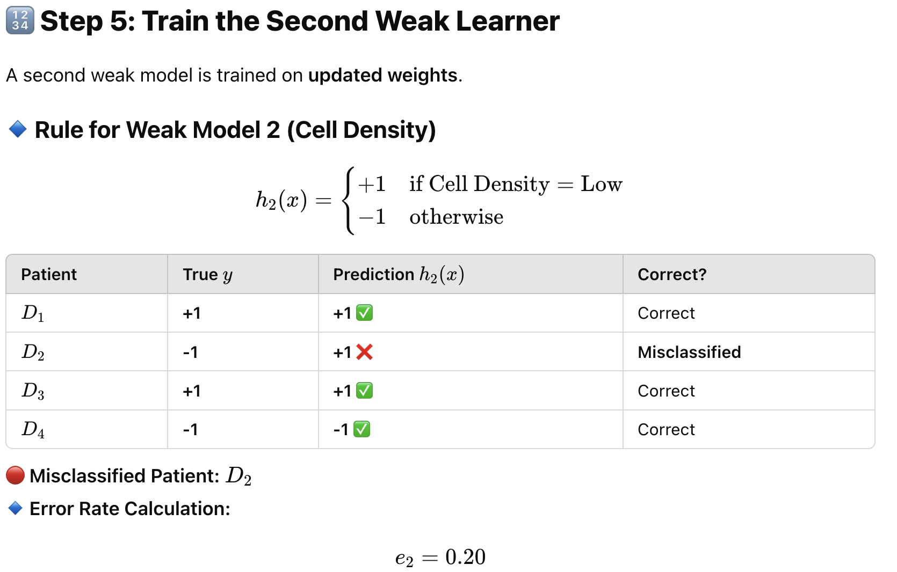

Slide 22
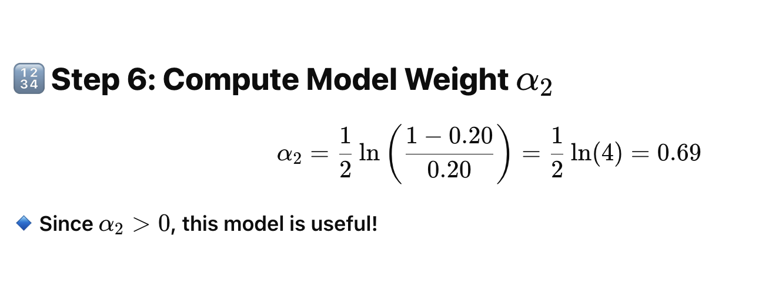

Slide 23
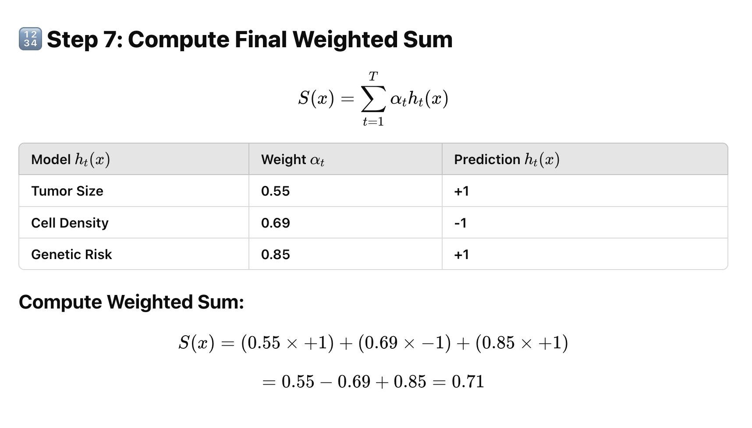

Slide 24
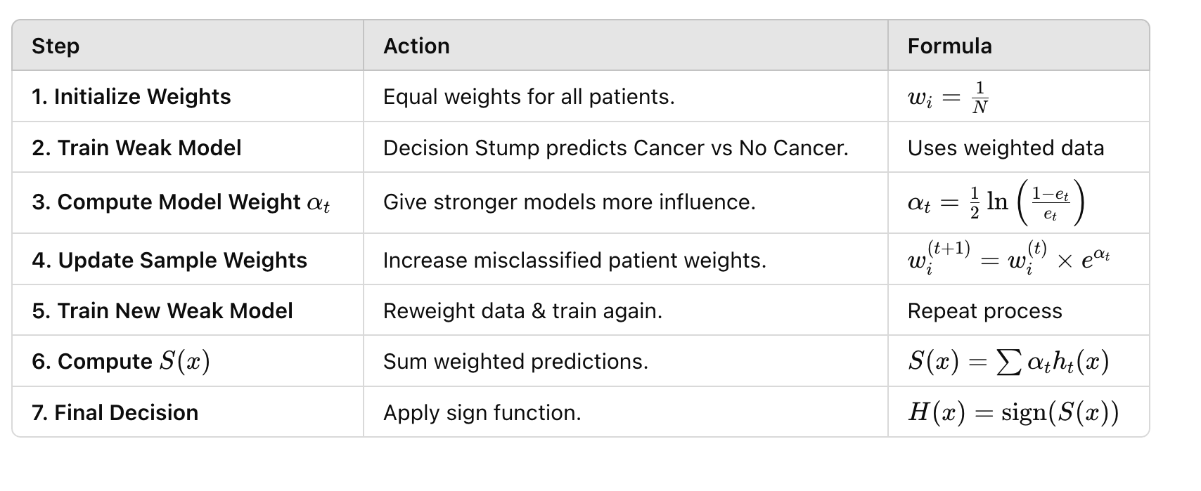

Slide 25
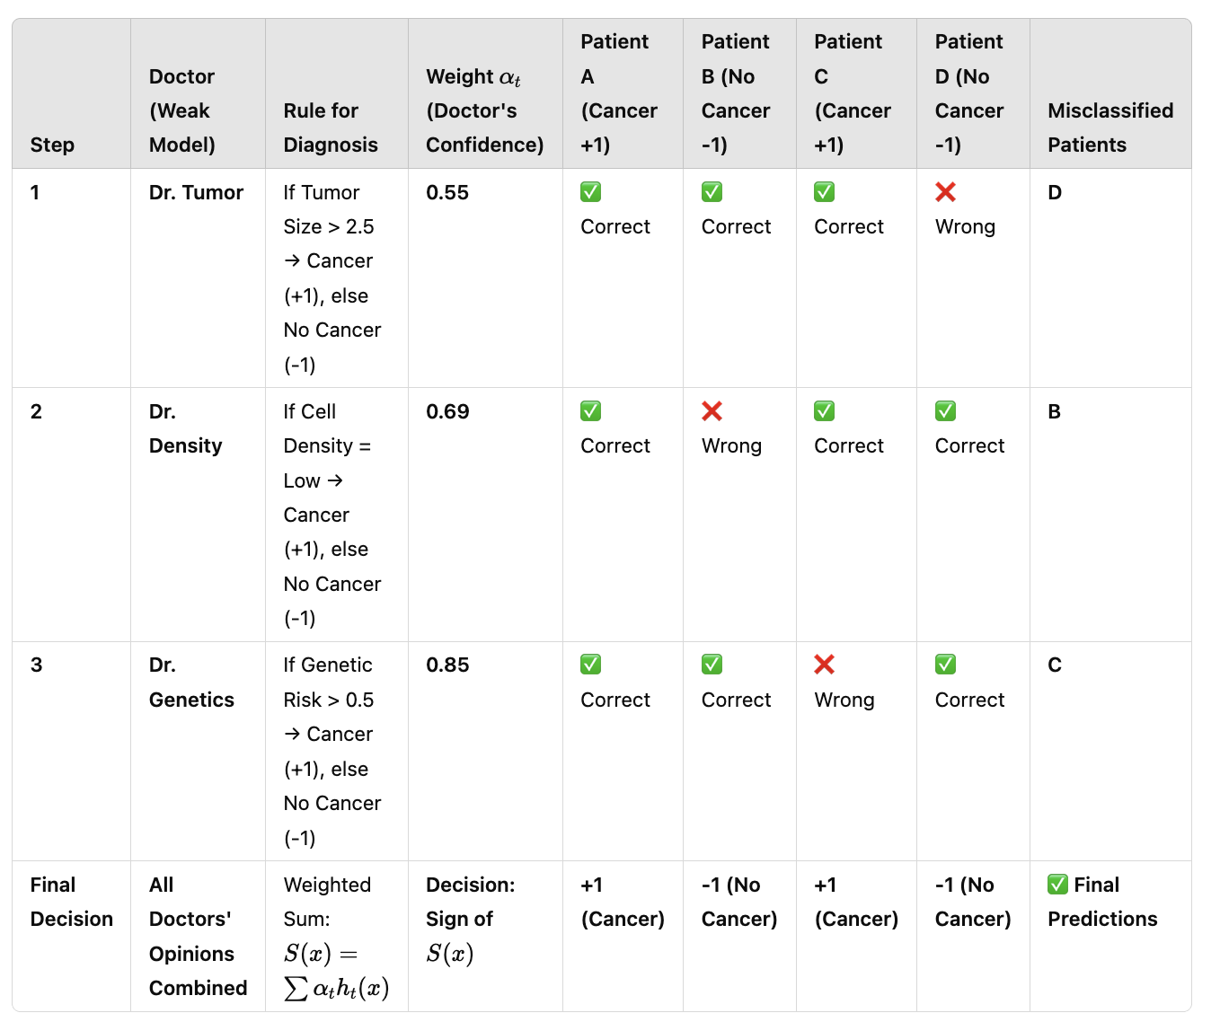

Slide 26
Boosting Algorithms Overview
Algorithm | Key Feature | Strengths | Use Case
AdaBoost | Focuses on misclassified samples. | Simple, effective for binary classification. | Spam detection, face recognition.
GBM | Minimizes residuals using gradient descent. | Flexible, handles regression and classification. | House price prediction, customer churn.
XGBoost | Optimized GBM with regularization. | Fast, scalable, high performance. | Large-scale datasets.
LightGBM | Leaf-wise tree growth for efficiency. | Faster training, lower memory usage. | Click-through rate prediction, big data.
CatBoost | Handles categorical features natively. | Robust, minimal hyperparameter tuning. | Customer behavior prediction, e-commerce.

Slide 27
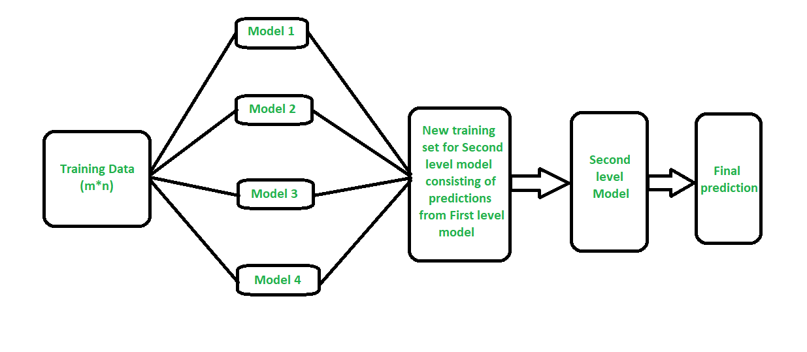
Stacking

Slide 28
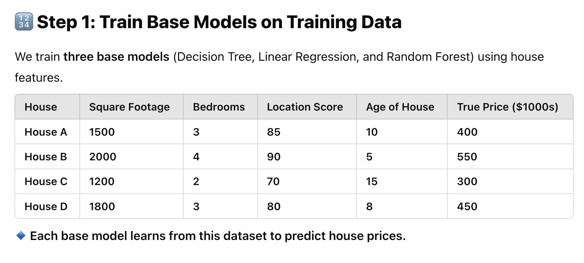

Slide 29
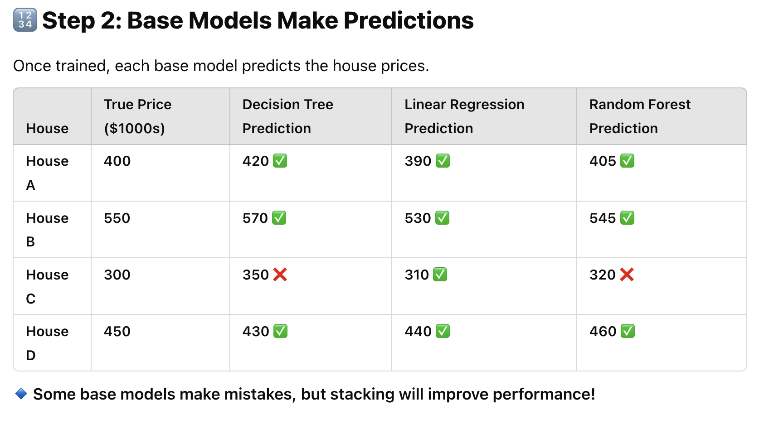

Slide 30
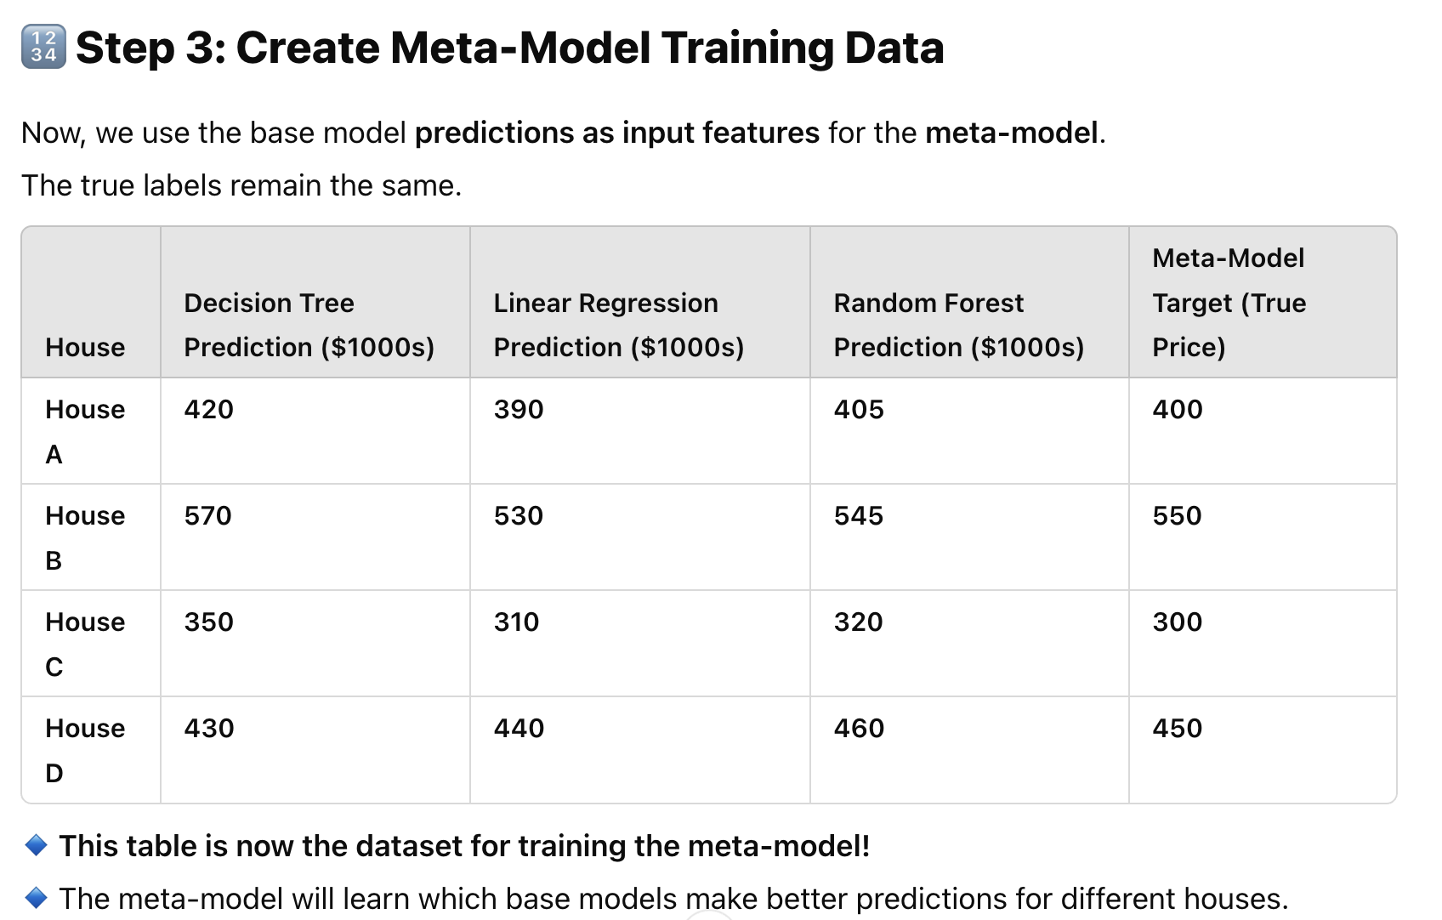

Slide 31
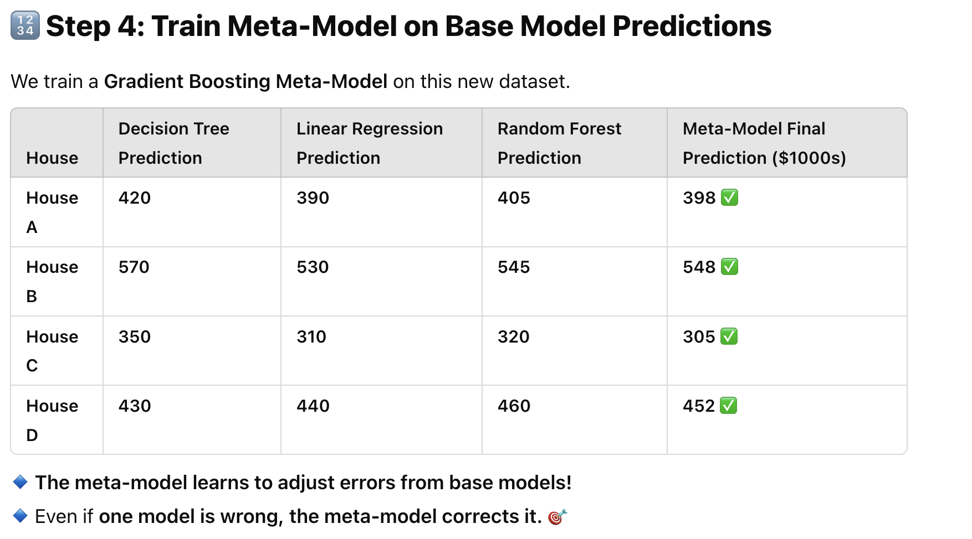

Slide 32
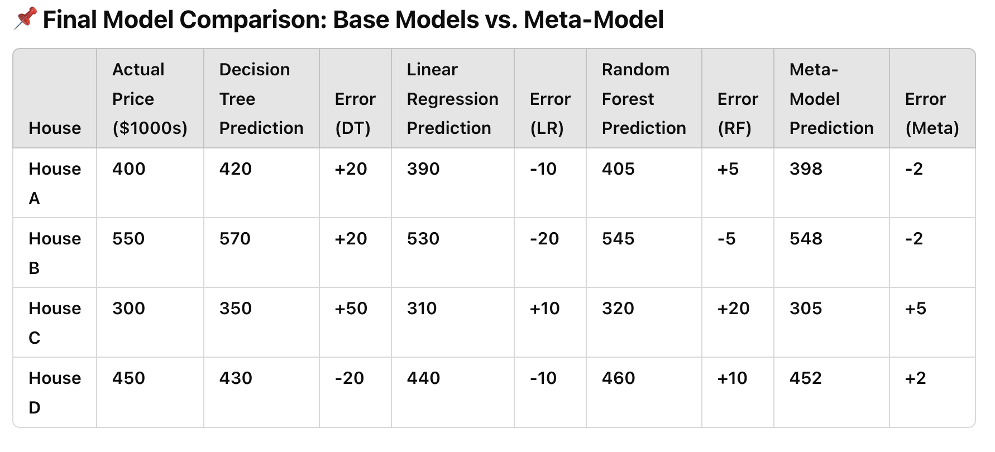

Slide 33
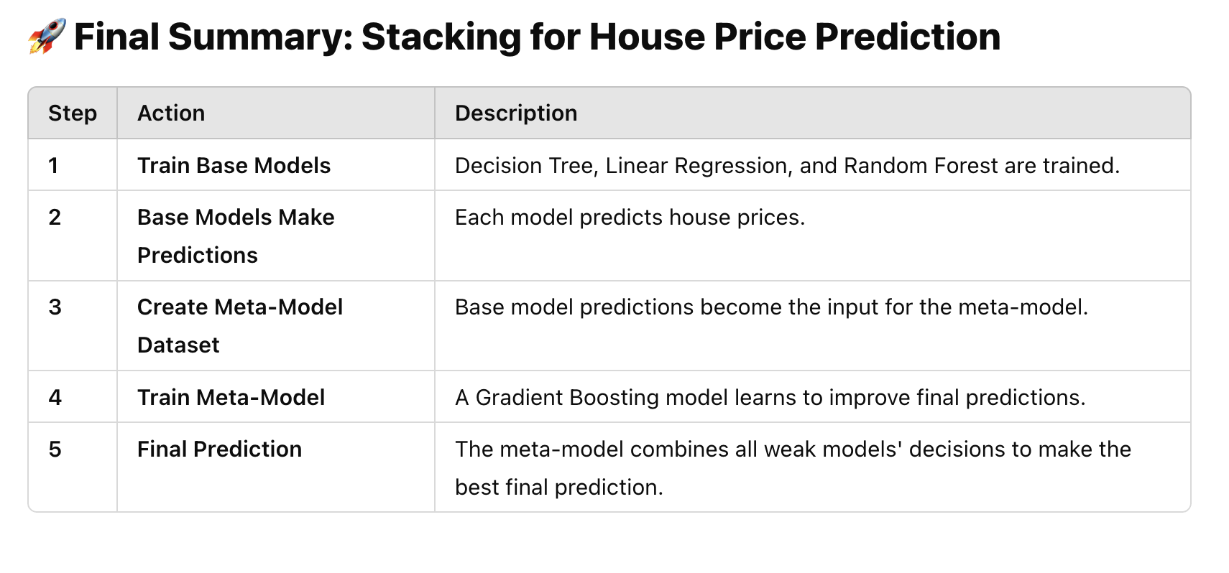

Slide 34
Understanding Hyperparameters
What Are Hyperparameters?
values/rules set before training and control how model learns
hyperparameters are not learned from data but are defined externally.
Examples of hyperparameters include
Learning rate (lr): controls how much model adjusts weights in response to errors.
Number of layers/neurons in a neural network: Defines the model architecture.
Tree depth (in decision trees, random forests, XGBoost, etc.): Controls model complexity.
Why Optimize Hyperparameters?
Hyperparameter optimization improves model performance
Maximize predictive accuracy
Reduce overfitting or underfitting
Improve generalization on unseen data.

Slide 35
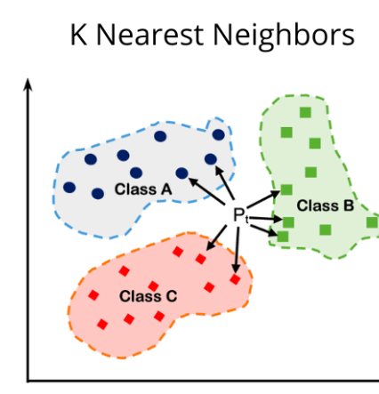
Hyperparameters in KNN
Number of Neighbors
Small: more variance but risk of overfitting
Large: less variance but risk of underfitting
Distance Metric
Euclidean
Manhattan
minkowski
Weighting Scheme
Uniform
Distance

Slide 36
Hyperparameters vs Parameters vs Statistics
Feature | Parameters | Hyperparameters | Statistics
Definition | Learned from data during training | Set before training to guide learning | Computed from a sample of data
Control | Defines model behavior | Controls learning process | Describes data properties
Examples | Weights in neural networks, coefficients in regression | Learning rate, number of trees in Random Forest | Mean, standard deviation, accuracy, RMSE
Learned or Set? | Learned during training | Manually set (or optimized) | Directly computed
Changes with New Data? | Yes | No (but can be re-tuned) | Yes (if sample changes)

Slide 37
Optimizing Hyperparameters
Grid Search
Random Search
Bayesian Optimization
Hyperband Optimization

Slide 38
Grid Search
Exhaustively searches all combinations of predefined hyperparameters.
Best for: Small search spaces where computational cost is manageable.
Example:
Decision Trees:
Hyperparameters: max_depth, min_samples_split, criterion.
Grid: max_depth = [3, 5, 10], min_samples_split = [2, 5, 10], criterion = ['gini', 'entropy'].
Evaluates all 18 combinations.

Slide 39
Random Search
Randomly samples hyperparameter combinations from search space.
Best for: Large search spaces where grid search is computationally infeasible.
Example:
Random Forest:
Hyperparameters: n_estimators, max_features, max_depth.
Randomly samples:
n_estimators = 100, max_features = 'sqrt', max_depth = 10.
n_estimators = 200, max_features = 'log2', max_depth = None.

Slide 40
Bayesian Optimization
What it does: Uses probabilistic models (e.g., Gaussian Processes) to predict the performance of hyperparameters and balances exploration and exploitation.
Best for: Medium to large search spaces where efficiency is critical.
Example:
XGBoost:
Hyperparameters: learning_rate, max_depth, subsample.
Bayesian model predicts optimal values:
learning_rate = 0.1, max_depth = 6, subsample = 0.8.

Slide 41
Hyperband
Speeds up random search by early stopping poorly performing configurations.
Best for: Large-scale hyperparameter tuning with limited resources.
Example:
Neural Networks:
Hyperparameters: learning_rate, batch_size, dropout_rate.
Evaluates multiple configurations and stops underperforming ones early.

